Slide 1
Local Shop Inventory Manager
Date => 20-08-2025
Presented by – Aryan Malik

Slide 2
Introduction
Overview:
Inventory management is crucial for businesses to keep track of stock levels.
Automating this process increases efficiency and reduces human error.
Objectives:
Learn to create an automated management system in Excel.
Understand key features and Excel functionalities to streamline inventory
processes.

Slide 3
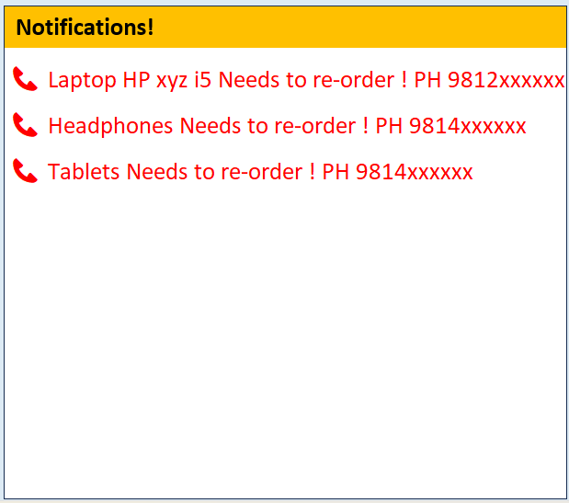
Key Features
Automated Notifications:
Receive alerts for low stock levels.
Easily contact vendors as needed.
Dynamic Updates:
Sales entries automatically update inventory levels.
Product details dynamically adjust with changes.

Slide 4
Initial Setup
Creating Icons:
Design and place inventory management icons in the Excel sheet.
Customizing Appearance:
Adjust colours, fonts, and general layout for better usability.
Ensure the interface is user-friendly and visually appealing.

Slide 5
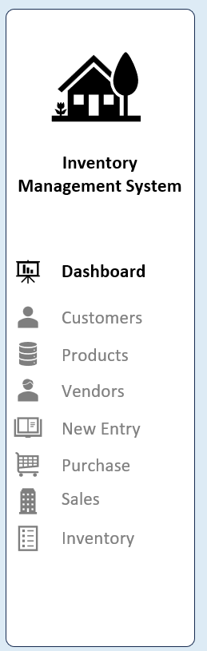
Structuring Your Excel Workbook
Efficient Organization:
Group related icons and shapes logically in the workbook.
Inserting Icons:
Use shapes and symbols to represent different inventory categories.
Align icons for a clean and professional appearance.

Slide 6
Linking and Formatting
Multiple Sheets Linking:
Create connections between different sheets to streamline data flow.
Formatting:
Adjust cell sizes, borders, and text alignment for clarity.
Use consistent fonts and colours for uniformity across the workbook.

Slide 7
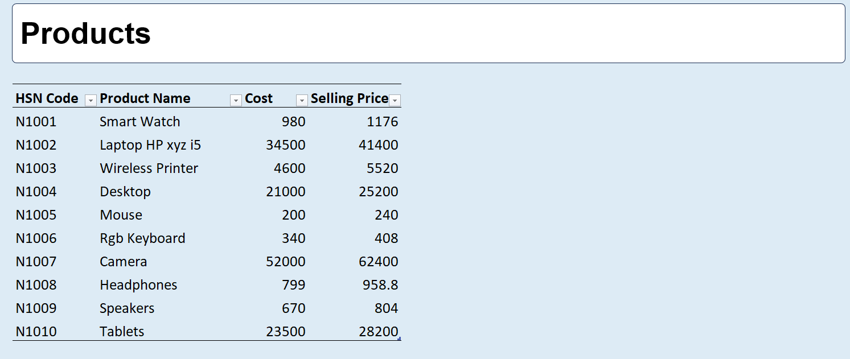
Tables for Data Management
Data Table Format:
Convert raw data into table format for efficient management.
Table Properties:
Customize table headers, shading, and filtering options.
Use tables to facilitate easy data entry and analysis.

Slide 8
Automating Inventory Management
Automated Inventory Sheet:
Develop an inventory sheet that updates automatically based on sales and purchase data.
Linked Entries:
Set up formulas to link purchase and sales data across different sheets.

Slide 9
Advanced Features
HSN Code Implementation:
Use HSN (Harmonized System Nomenclature) codes for better categorization.
VLOOKUP Automation:
Automate product name and cost retrieval using VLOOKUP.
Enhance inventory reporting accuracy with real-time data.

Slide 10
Error Handling and Formula Usage
Error Formulas:
Implement IFERROR and other handling functions to manage exceptions.
Formula for Customer IDs:
Use Excel formulas to automatically retrieve customer IDs and management.

Slide 11
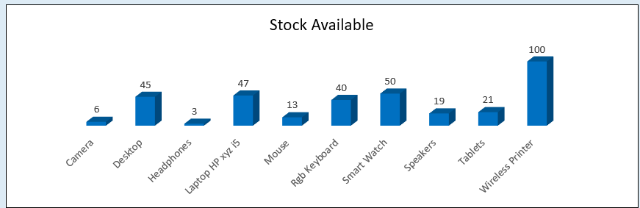
Stock Tracking and Calculations
Calculate Stock Levels:
Use formulas to compute stock quantities based on purchases and sales.
Track Products Stock:
Leverage VLOOKUP and other functions for real-time tracking of inventory status.

Slide 12
Reporting and Analysis
Creating Pivot Tables:
Use Pivot Tables for deep analysis of inventory data.
Generate summary reports on sales and stock levels.
Dashboard Creation:
Build a performance summary dashboard for visual insights.

Slide 13
Automated Alerts and Notifications
Setting Up Alerts:
Create formulas to trigger alerts for low inventory levels.
Automated Reorder Process:
Establish process for reorder notification based on inventory thresholds.

Slide 14
Visualization
Bar Charts:
Customize dashboard layout for effective data representation.
Filters and Visuals:
Use Excel filters to enable quick access to specific data subsets.
Leverage visual aids for clearer data interpretation.

Slide 15
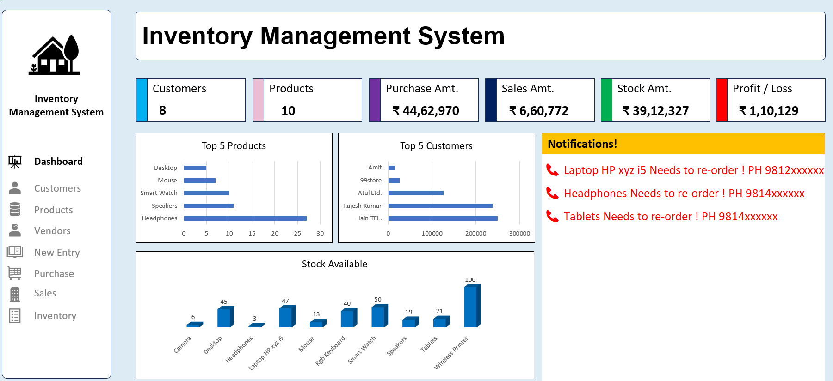
Dashboard Creation
Designing Dashboard:
Customize dashboard layout for effective data representation.
Steps for Dashboard:
Outline steps to link product availability and purchase amounts for at-a-glance insights.

Slide 16
Manual and Automatic Updates
Manual Refresh:
Note importance of refreshing data manually for real-time updates.
Streamlining Insights:
Discuss benefits of automated processes in enhancing data analysis.

Slide 17
Conclusion
Summary:
Highlight the benefits of an automated inventory management system:
- Increases accuracy and efficiency.
- Reduces manual efforts and potential errors.

Slide 18
THANK YOU
ARYAN MALIK
INDIAN INSTITUTE OF TECHNOLOGY PATNA

